Slide 1
DocumentsCorePack for Microsoft Dynamics 365 & Power Apps
www.mscrm-addons.com

Slide 2
The #1 Document Automation Solution
No matter which industry or department, DocumentsCorePack helps you address your specific document requirements and focus on achieving your goals and growing your business. Suitable for every business case, our solution offers powerful and user-friendly features to simplify, optimize and automate document processes, from creation to electronic signature to complex document requirements.
CHALLENGES
OUR SOLUTION
DESIRED OUTCOMES
Time-intensive document creation
Create professional documents (PDF & Word) directly from Dynamics 365
High risk of data entry errors
Significant amount of time each day on the creation and sending out documents
DocumentsCorePack allows fast and simple document creation and offers a set of tools to process documents efficiently!
Document generation, processing & automation based on Dynamics 365 data has never been easier!
Tremendous time-savings
Increased productivity & work efficiency
Easy & intuitive template design and maintenance
Improved customer experience: reduced errors, elimination of manual entry errors through automation and standardization of document processes in your business
Notes:
A lot of document s- it has to be simple. – non manual
Donations, PowerApps Portal integrations

Slide 3
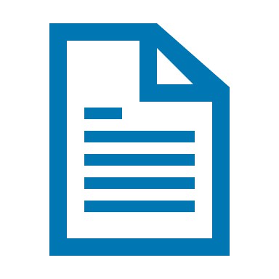
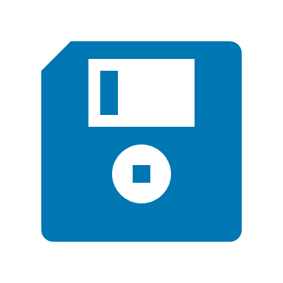
Key Features
TEMPLATE DESIGN
E-SIGNATURE
SHAREPOINT INTEGRATION
Design dynamic and professional document templates using the powerful features of Microsoft Word supporting advanced filtering, sorting & repeating tables. No programming skills are required!
DocumentsCorePack integrates e-Sign solutions, such as AdobeSign, AssureSign & DocuSign, that allow you to define your e-Signature fields and trigger the electronic signature process.
Save documents automatically to the corresponding document location on SharePoint. Auto-creation of folders (as well as dynamic save-locations) is supported.
POWER AUTOMATE FLOW
RELATIONSHIPS
ONE-CLICK ACTIONS
Design dynamic and professional document templates using the powerful features of Microsoft Word supporting advanced filtering, sorting & repeating tables. No programming skills are required!
All Dynamics 365 relationship-types are supported. There is no limitation on the number of relationships or levels resolved.
Preconfigure document processes to just one click to e.g. create a document, generate PDF, send PDF as an e-mail and save to SharePoint.
And many more…
Notes:
A lot of document s- it has to be simple. – non manual
Donations, PowerApps Portal integrations

Slide 4
DocumentsCorePack: Core Document Capabilities
1. Design
Microsoft Word based templates
PDF, DocX, HTML, ...
Map fields from Dataverse
2. Generate & Deliver
Send via E-mail
Send for E-signature
Save to SharePoint
Print
Run Flow, …
3. Automate
DocumentsCorePack Connector
Examples:
Confirmations
Approvals
Dynamics 365 / Model Driven & Canvas Apps
Power Automate (Flows)

Slide 5
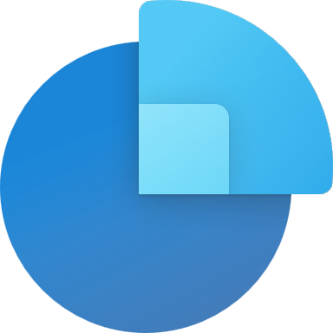
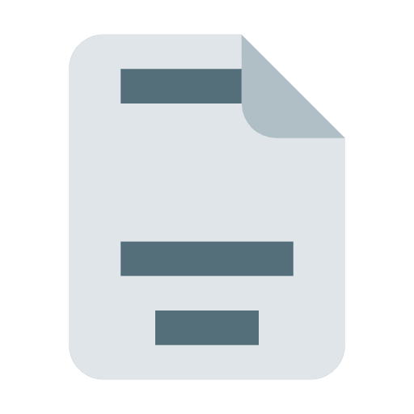
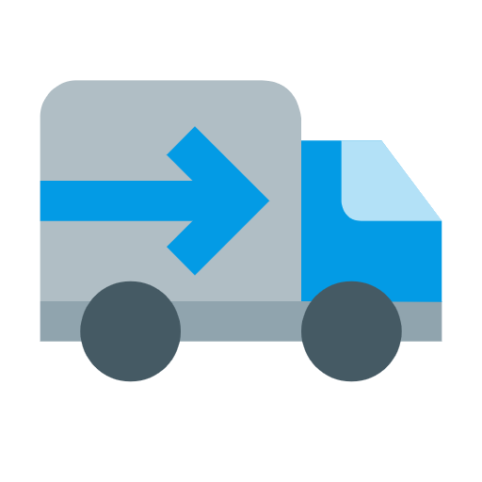
Use cases: Documents on the Power Platform
Sales Cycle
New Lead
Work on Opp
Getting close ☺
Deal closed
Personal. Info
NDA‘s, Contracts
Quotes
Invoices
Specifications
SOW‘s
PO‘s
Payment/Ship. confirmations
Marketing
Service
Custom Business Apps
Documents in Customer Journey
Service reports
Dataverse
Personalized campaign
Contracts
Model Driven Apps
Canvas Apps
Student certificates
Work-Orders
Power Automate
Notes:
A lot of document s- it has to be simple. – non manual
Donations, PowerApps Portal integrations

Slide 6
DocumentsCorePack: Utilization
Source: mscrm-addons.com survey Dez. 2021

Slide 7
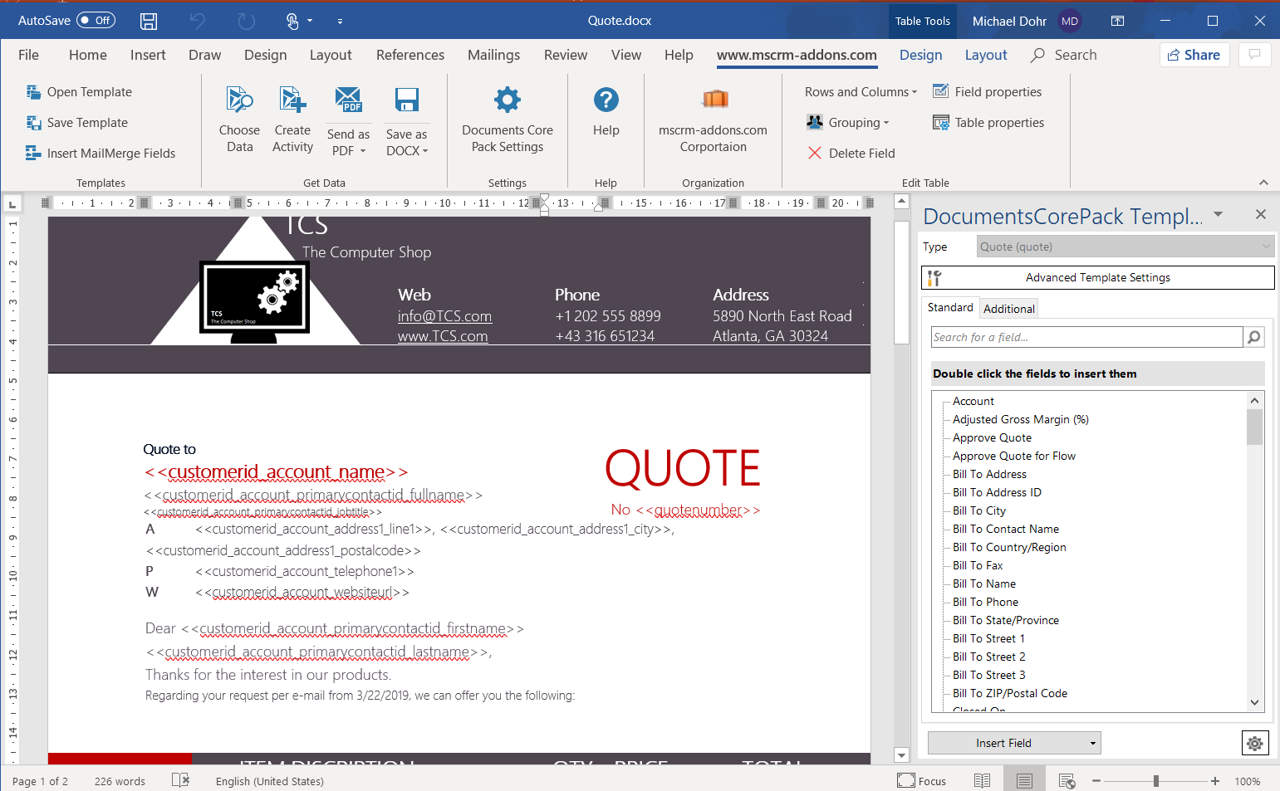
1. DESIGN your templates in Microsoft Word
Use the Power of Microsoft Word
Map fields from Dataverse
All attributes supported
Unlimited relationships
Looping, sorting, filtering,
…
Special features:
Embed field values
Embed documents & pictures
Tables & loops for related records
Predefine e-Signature fields
Charts,.…

Slide 8
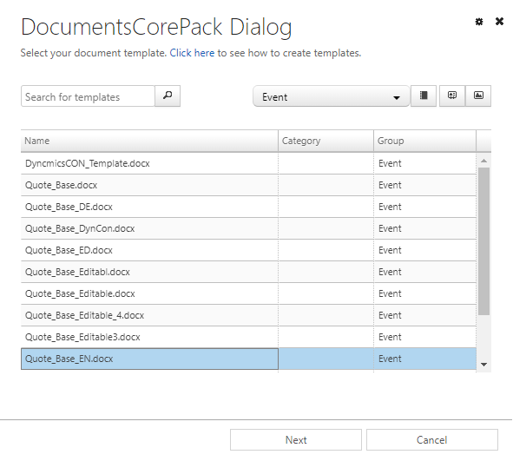
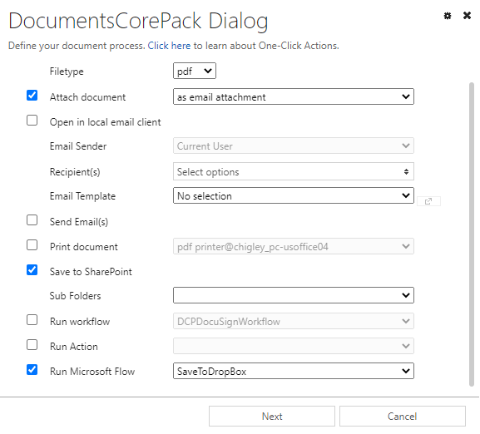
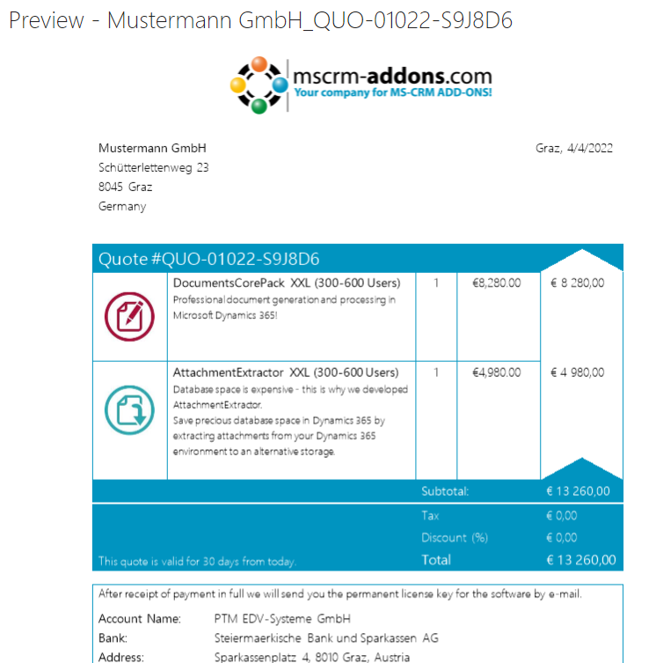
2. GENERATE & DELIVER documents from Dynamics 365 & Model Driven Apps
Perform document processes from the Command-Bar:
Select template
Define processing
Review & edit
All Processing options & Flow interface
Single & batch record processing
One-Click Actions: Predefine your document processes to a single click

Slide 9
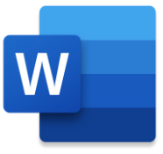
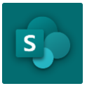
3. AUTOMATE your documents
DocumentsCorePack Connector
Create document
Send by E-mail,
Print (Local & Cloud)
Sign (e-Signature)
Save to SharePoint
25+ actions available
Core Benefits
Reduced user workload
Standardized & improved customer experience
Triggered by data (100+ options)
Approval (e.g. Quote Active)
Lead entry
Scheduled documents
Weekly/monthly reports
Overdue notices
Approvals
Power Automate (Flow)
Power Apps

Slide 10
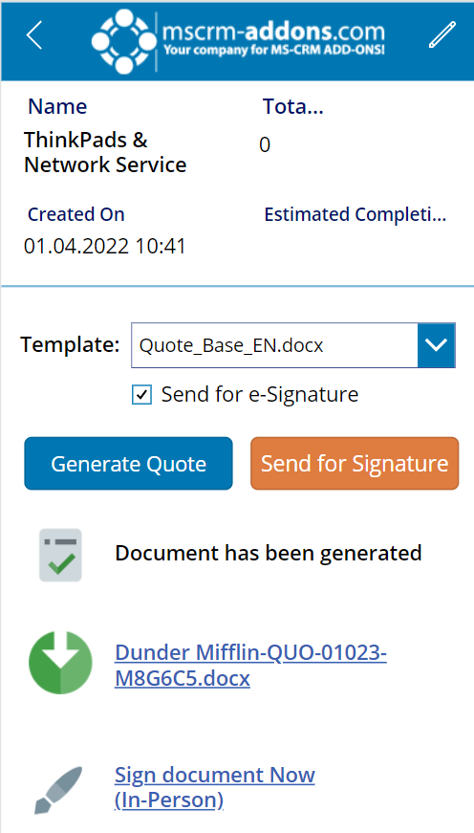
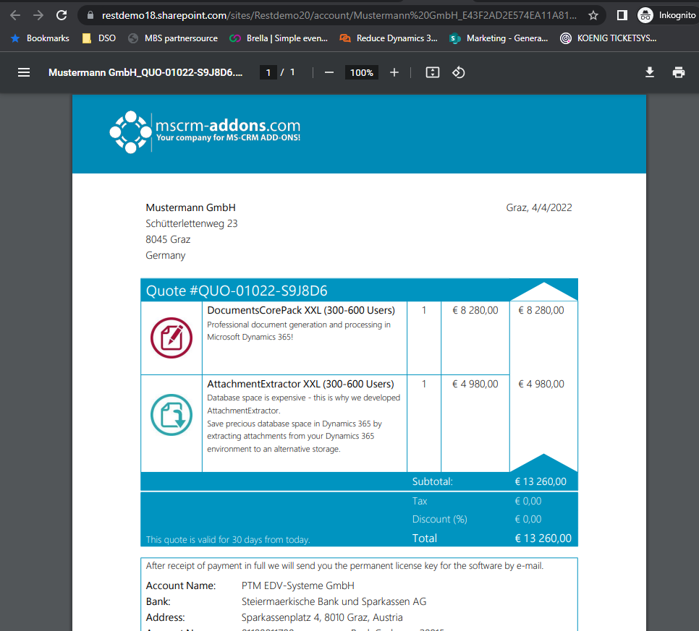
4. Empower your Canvas App
Add document capabilities to your Canvas App
25+ Connector Actions available
Generated document returned to App for visualization & processing

Slide 11
Real Life Scenarios
Event Communication
“The entire communication is done using DCP. 1. Confirmation email after subscribing to an event, 2. Sending a reminder one week before the event, 3. Sending a reminder one day before the event and 4. Send an NPS survey after the event. Fully automated Power Automate flows.”
Key Benefits
Increased productivity and workforce efficiency
Time & Cost savings
Reduced users' workload, frustration and human errors
Improved customer experience & document quality
Donations „The best functionality is the 'Request for donation‘. With DCP we can send letters to potential donors and request donaties for projects via QR codes. Customer scans the QR leading to a donation page. The donation shows up in our CRM automatically and a Thank you letter and confirmation gets sent. Closed loop.“
Invoice Automation “I have set up a Cloud Flow that triggers when a user sets an Order through to an Invoice. The flow determines the kind of invoice (to be printed or e-mailed) creates the invoice in pdf and attaches the file to an email or sends it to a printer. The e-mail is sent from the mailbox of the corresponding department to the debtor's email. Additionally, the document is stored in our Blob Storage.”

Slide 12
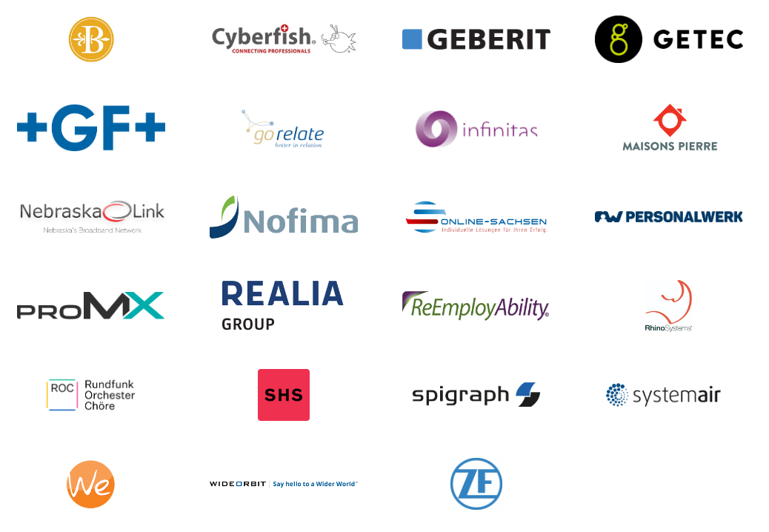
Customer Statistics and Benchmarks
Active customers: 2500+
Enterprise (>1500): 35
Highest # of users: 8000
Highest utilization: 3.6 Mio docs p.a.
Success Stories Comparision Chart

Slide 13
Use Cases/Customer Success Stories
Realia Group
Finland, Sweden & Baltics
SystemAir 1600 users, 49 countries
Challenge:
Time-consuming manual handling of documents
Information were consumed and produced in form or traditional documents
Solution:
Document automation inside workflows
Automated ptocess of document management
Worktime savings up to one hour per meeting
Read Case Study
Challenge:
Standardize & simplify quoting process
Complex quotes consisting of various elements
Localization (> number of templates)
Editing necessary
Solution:
DocumentsCorePack One-Click-Actions
Templates automatically selected
Minimal User-interaction upon quoting
Read Case Study

Slide 14
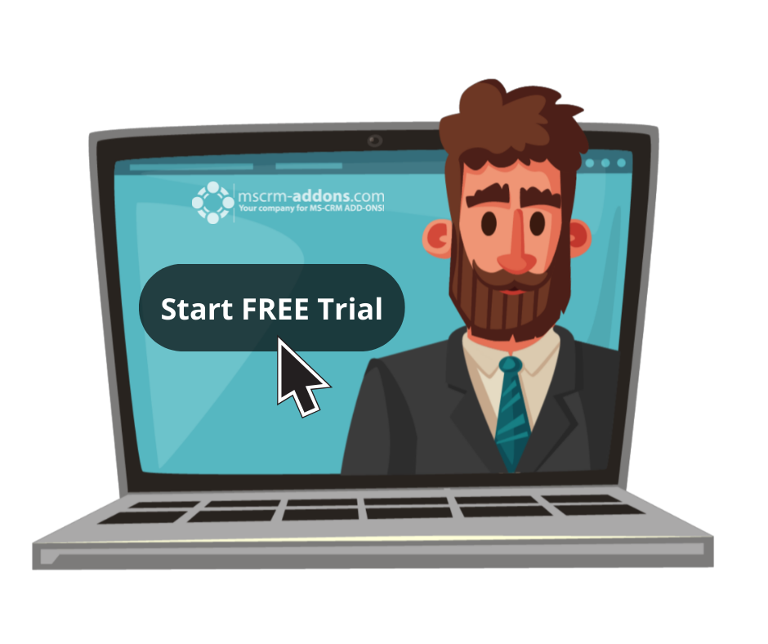
Free Trial
Free Trials Available for all Add-Ons
No functional limitations
Fully supported
~30 minutes to get started

Slide 15
Getting Started
Create a DocumentsCorePack Service Service Setup: Online Service Configuration Step-by-Step: How to setup a DocumentsCorePack service
Download and Install the Template Designer Download: DocumentsCorePack Downloads Step-by-Step: Installation of the Template Designer
Design your first template Step-by-Step tutorial: Create a DocumentsCorePack template Step-by-Step video: Create and test a quote template (Youtube)
That’s it! Our solution will run in trial mode for 14 days automatically If you need an extension, simply contact your Partner Manager or our support team and ask for keys!
All trials are fully supported. Don’t hesitate to get in touch with our Support Team should you have any questions!
Note: for On-Premise Deployments see: Download Area

Slide 16
Pricing EUR
License model: Subscription
Support & Maintenance is included
DocumentsCorePack packages | Monthly | Annually | Template Designer incl. | Sandbox Environments incl.
XS (1 – 10 users) | € 65 | € 690 | 1 | 1
S (11 – 30 users) | € 105 | € 1.140 | 1 | 1
M (31 – 80 users) | € 175 | € 1.770 | 2 | 2
L (81 – 140 users) | € 225 | € 2.400 | 2 | 2
XL (141 – 300 users) | € 460 | € 4.990 | 5 | 3
XXL (301 – 600 users) | € 870 | € 9.060 | 10 | 5
Enterprise ( 600+ users) | On request | On request
License Model: Subscription
Additional | Monthly | Annually
Template Designer | € 8,00 | € 80,00
Add. 1.000 documents/month | € 12,00 | € 100,00
Add. Sandbox | € 60,00 | € 690,00

Slide 17
Pricing USD
License model: Subscription
Support & Maintenance is included
DocumentsCorePack packages | Monthly | Annually | Template Designer incl. | Sandbox Environments incl.
XS (1 – 10 users) | $ 80 | $ 825 | 1 | 1
S (11 – 30 users) | $ 145 | $ 1,500 | 1 | 1
M (31 – 80 users) | $ 240 | $ 2,520 | 2 | 2
L (81 – 140 users) | $ 310 | $ 3,240 | 2 | 2
XL (141 – 300 users) | $ 590 | $ 6,000 | 5 | 3
XXL (301 – 600 users) | $ 1,120 | $ 11,760 | 10 | 5
Enterprise ( 600+ users) | On request | On request
License Model: Subscription
Additional | Monthly | Annually
Template Designer | $ 10 | $ 110
Add. 1.000 documents/month | $ 15 | $ 150
Add. Sandbox | $ 80 | $ 825

Slide 18
Thank you!
www.mscrm-addons.com
support.mscrm-addons.com
Youtube Channel (How To's, Use-Cases)
info@mscrm-addons.com
EMEA: +43 316 680 880
U.S.: +1 404 720 6066

