Slide 1
PowerSearch for Microsoft Dynamics 365 & Power Apps
www.mscrm-addons.com

Slide 2
The Power of Global Search & Advanced Find Combined
SEARCH CAPABILITIES
Simple UI for complex queries
Field specific
All search operators supported
AND/OR keywords
User-specific defaults
WORKING WITH RESULTS
Customizable grid with access to results and related records
Open in Dynamics 365 grid: bulk edit, run workflow…
Result preview
Execute workflows/actions against results (single and bulk)
CONFIGURATION
Fully customizable search and result fields (Width, operators,...)
Customizable preview supporting views of related records and actions
Fetch-Import: Use Advanced Find as a query-designer
Notes:
Another business problem we are providing a solution for is: Tracking of phone calls. One huge value of a CRM system is that all customer interaction is stored and can be reviewed in order to decide whats best next.
Unfortunately its quite a lot of clicks to e.g. Store a phone call (create, enter data, lookup contact/lead, regarding etc. )
Dialing: provide a simple methdo of initiating phone calls with contacts.
Power-dialing – telemarketing/inside sales teams etc.
So we aim to rpovide a single interface to many phone systems. On the right you can see some of the supported vendors. (old fashioned systems but, likewise to the market, we are seeing more demand for support of VOIP based systems like Skype for business or Ringcentral)

Slide 3
Key Features
SEARCH QUERIES
ALL SERCH OPERATORS
FULL AUTOMATION
Create complex, yet easy-to-use advanced searches in multiple columns.
PowerSearch fully supports all known operators from Advanced Find.
Frequently parameters can easily be saved in pre-defined query lists.
AND/OR SEARCH
RESULT PREVIEW
CUSTOMIZABLE GRID
Support of "and/or" keywords as search input.
Get a direct preview of result records without the need to open them individually. Previews are fully customizable to fit your needs.
Show results in a customizable grid view. Results as well as related records can be accessed with a single click.
And many more…
Notes:
A lot of document s- it has to be simple. – non manual
Donations, PowerApps Portal integrations

Slide 4
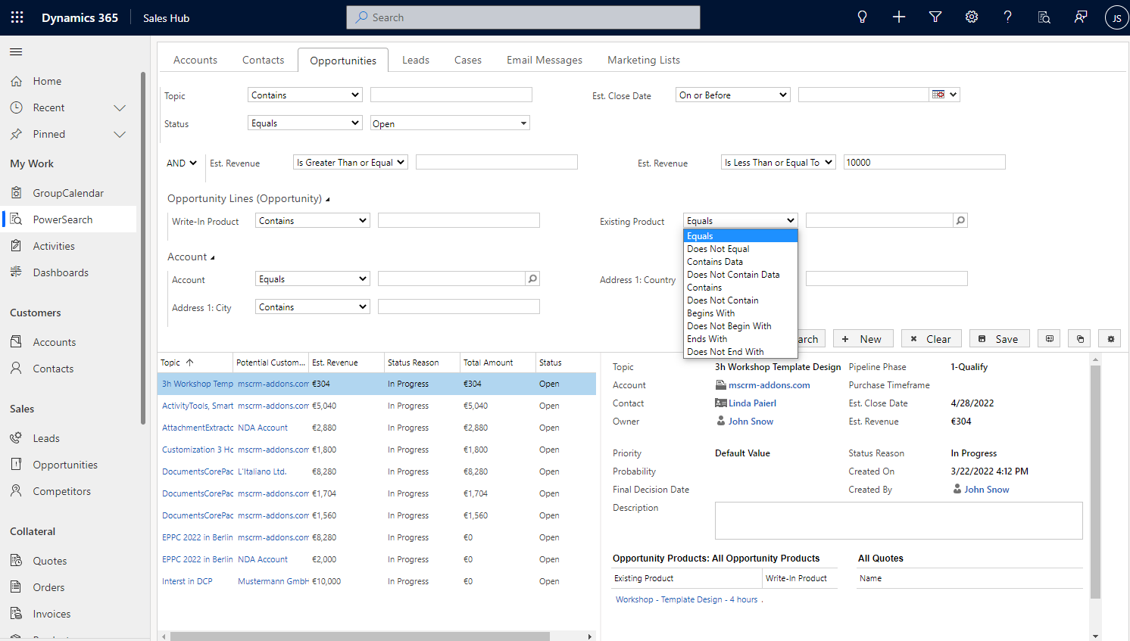
Searching the Dataverse made easy
Search Pane: Predefined queries with optional defaults
All operators supported, AND/OR keywords
Extend the search to related records
Key Benefits
Increased Productivity
Save time spent searching records
Quick access to results
User Adoption
Simplify redundant tasks
Reduced clicks
Preview: Customizable List and Preview
Execute actions against results
Notes:
Company overview - ~1 min
- Locations (+US) – better support service
Gold partner + certified solutions
Speaker: 1 sentence –

Slide 5
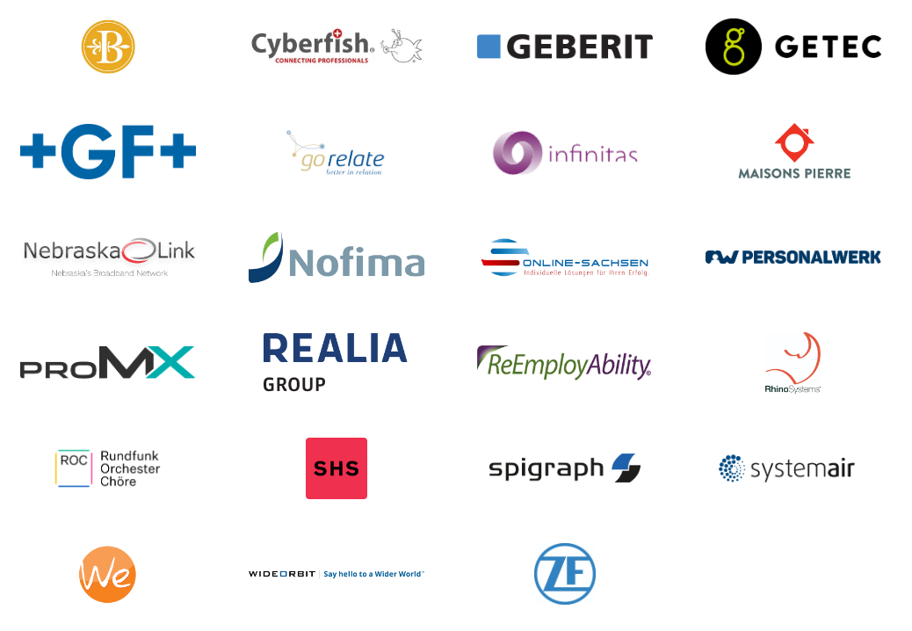
Customer Statistics and Benchmarks
Active customers: 100+
SMB to enterprise
Highest # of users: 5500
Success Stories

Slide 6
Use Cases/Customer Success Stories
SystemAir 1600 users, 49 countries
Challenge:
The Dynamics 365 intern search function
A lot of room for improvement
Missing functionalities
Solution:
The collaboration led to a totally new, innovative product PowerSearch
Combines the simplicity of standard search with the capabilities of Advanced Find
Improvement of the Dynamics 365-intern search function
Read Case Study
Notes:
A lot of document s- it has to be simple. – non manual
Donations, PowerApps Portal integrations

Slide 7
Free Trial
Free Trials Available for all Add-Ons
No functional limitations
Fully supported
~30 minutes to get started

Slide 8
Getting Started
Download & install PowerSearch
Online: AppSource
On-Premise: http://www.mscrm-addons.com/Downloads
Getting Started with PowerSearch for Dynamics 365 Online: Find AppSource installation steps here On-Premise: Execute the downloaded msi-file on the Dynamics 365-server. In the Dynamics 365-settings, navigate to the „mscrm-addons.com“ section and click on the „Products“-tab. Here, select PowerSearch. The „Web License Manager“ opens. It allows you to customize your configuration or use the default one.
That’s it! Our solution will run in trial mode for 14 days automatically If you need an extension for a customer, contact our support team and ask for keys!
Info: http://www.mscrm-addons.com/Products/PowerSearch
Mscrm-addons.com is fully supporting trials – If you have any questions, don’t hesitate to get in touch with our support team via
- Live-Chat (available 17 hours a day)
- E-mail to support@mscrm-addons.com

Slide 9
Getting Started
Download and Install PowerSearch Download: AppSource Find AppSource installation steps here
Info: http://www.mscrm-addons.com/Products/PowerSearch
That’s it! Our solution will run in trial mode for 14 days automatically If you need an extension, simply contact your Partner Manager or our support team and ask for keys!
All trials are fully supported. Don’t hesitate to contact our Support Team should you have any questions!
- Live-Chat (available 17 hours a day)
- E-mail to support@mscrm-addons.com
Note: for On-Premise Deployments see: Download Area

Slide 10
Pricing EUR
License model: Subscription
Support & Maintenance is included
Component | Price /license monthly /annually | Support & Maintenance
Per Site license (Must cover all active users) | € 2,50 / € 2,00 | Included
Annual subscription (Minimum of 10 users) | € 5,00 / € 4,00 | Included

Slide 11
Pricing USD
License model: Subscription
Support & Maintenance is included
Component | Price /license monthly /annually | Support & Maintenance
Per Site license (Must cover all active users) | $ 3.00 / $ 2.50 | Included
Annual subscription (Minimum of 10 users) | $ 6.00 / $ 5.00 | Included

Slide 12
Thank you!
www.mscrm-addons.com
support.mscrm-addons.com
Youtube Channel (How To's, Use-Cases)
info@mscrm-addons.com
EMEA: +43 316 680 880
U.S.: +1 404 720 6066

