Slide 1
TelephoneIntegration for Microsoft Dynamics 365 & Power Apps
www.mscrm-addons.com

Slide 2
Connect your Phone System to Dynamics 365
No matter which industry or department, our solution provides you with a simple and intuitive user experience to help you bridge the gap between your phone system & Dynamics 365. Our free “Phone Test Tool” can be used to quickly verify your phone system’s compatibility prior to purchase.
CHALLENGES
OUR SOLUTION
KEY BENEFITS
Do your service & sales teams struggle to take incoming calls and talk to customers while having to search for & review their recent history - all while capturing the important call details at the same time?
TelephoneIntegration connects your phone system with Dynamics 365 and helps you save valuable time and increase your productivity through simplifying call handling in Dynamics 365.
Features like Caller Recognition, Screen-Pops and auto-creation of Dynamic 365 records (calls, opportunities, cases,…) help you capture & track phone calls and reduce clicks. Simplified dialing with Click-2-Dial, ‘Dialing from related records’ guarantees a professional and personal calling experience.
Notes:
A lot of document s- it has to be simple. – non manual
Donations, PowerApps Portal integrations

Slide 3
Key Features
CALLER RECOGNITION
SCREEN POPS
AUTO CREATE RECORDS
Once a call is recognized, our CTI will search the Dynamics 365 system and display information about the caller.
Dynamics 365 records and phone call activities can be configured to automatically pop-up on incoming and outgoing calls.
Create new records on incoming calls; e.g. opportunities, cases, accounts, contacts or leads.
CLICK-2-DIAL
CALL STATISTICS
POWER DIALER
Next to any phone number field in Dynamics 365, the Click-2-Dial option is available from the search, as well as from the CommandBar.
Analyze calling times and the performance of your sales or service reps.
Based on campaign activities, the "Power Dialer" enables semi-automated call queues.
And many more…
Notes:
A lot of document s- it has to be simple. – non manual
Donations, PowerApps Portal integrations

Slide 4
TelephoneIntegration: connect your phone system to Dynamics 365
Capture & track phone calls
Caller Recognition /Screen-Pops
Create activities (Phone calls, appointments, e-mails...)
Create records (Cases, opportunities, leads,..)
Call statistics & call analysis
Simplify dialing
Click-2-dial from phone fields or CommandBar
Call from related records(E.g. Quotes, opportunities, cases)
Power-dialing: Workspace for the efficient calling of lists
Dynamics 365
Customer Engagement
Model Driven Apps
Canvas Apps
TelephoneIntegration
Phone System
Notes:
Another business problem we are providing a solution for is: Tracking of phone calls. One huge value of a CRM system is that all customer interaction is stored and can be reviewed in order to decide whats best next.
Unfortunately its quite a lot of clicks to e.g. Store a phone call (create, enter data, lookup contact/lead, regarding etc. )
Dialing: provide a simple methdo of initiating phone calls with contacts.
Power-dialing – telemarketing/inside sales teams etc.
So we aim to rpovide a single interface to many phone systems. On the right you can see some of the supported vendors. (old fashioned systems but, likewise to the market, we are seeing more demand for support of VOIP based systems like Skype for business or Ringcentral)

Slide 5
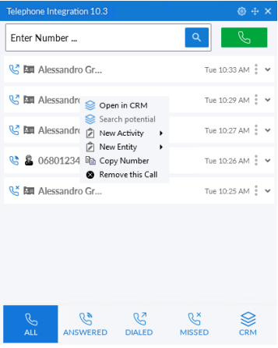
User Interface
Desktop Application
User interface
Bridge to phone system
Search records
Create activities
Create records
User-specific settings
Key Benefits
Reduced data loss
Increased productivity & user adoption
Reduced clicks & user frustration

Slide 6
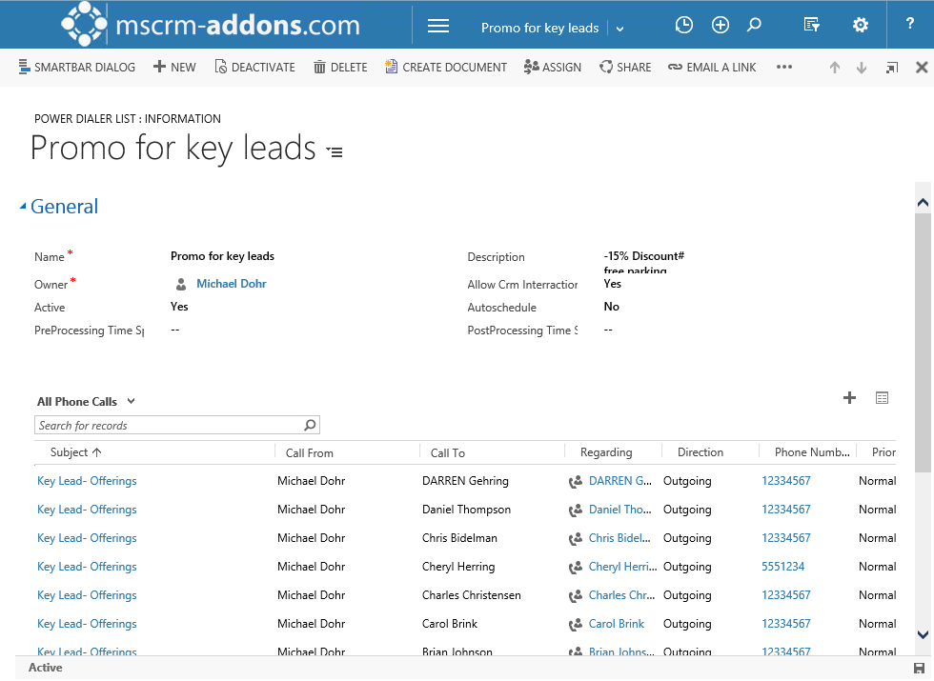
Inside Sales (Power Dialing)
Power-Dialer: Workspace for the efficient calling of lists
Call Lists (Campaigns)
End of the year offering
Key customers
Web registrations (Autofilled)
Event followups
…
Sales Team

Slide 7
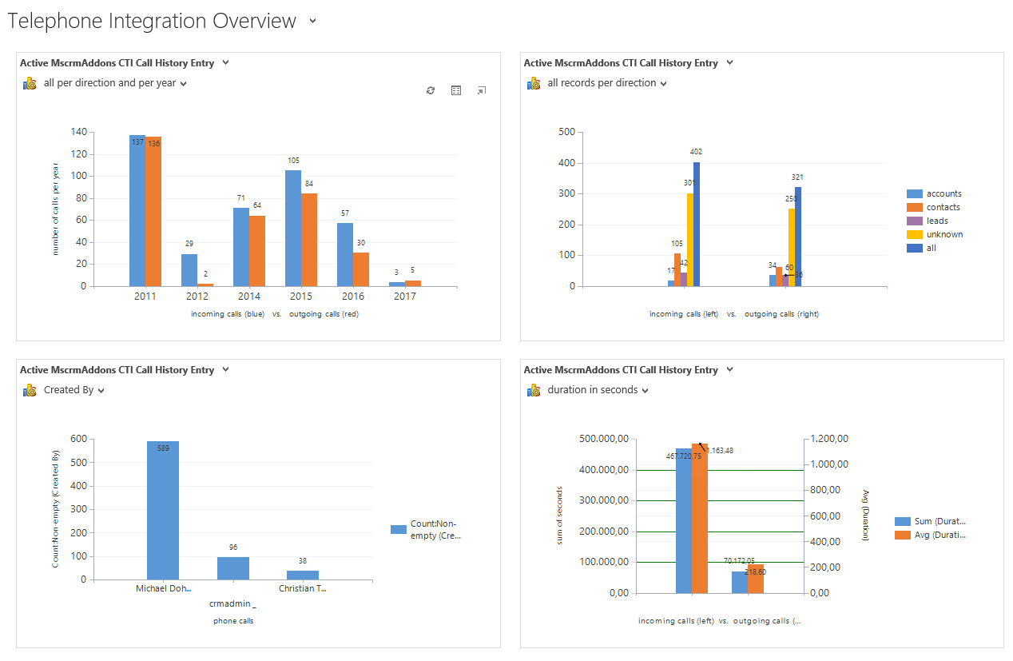
Call Statistics
Visualize and analyze phone calls in Dynamics 365

Slide 8
Customer Statistics and Benchmarks
Active customers: 250+
Highest # of users: 700
Success Stories

Slide 9
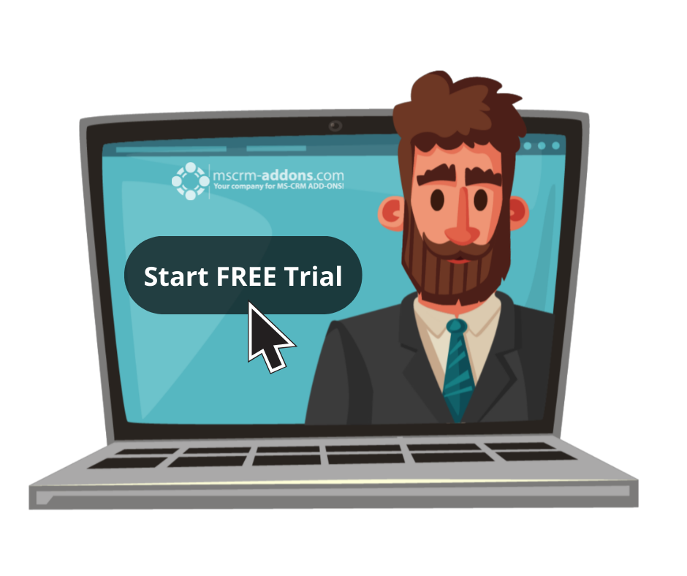
Free Trial
Free Trials Available for all Add-Ons
No functional limitations
Fully supported
~30 minutes to get started

Slide 10
Getting Started
Test the compatibility of your phone system It is recommended to first test the compatibility of your phone system with the Phone Test Tool
Download & install TI-Server and TI-Client
Online: AppSource
Find AppSource installation steps here
TI-Server (Single install): You can install the server component on any PC. It will act as the host to the global configuration and license. TI-Client: You will have to install the client on each PC you want to provide the CTI too.
That’s it! Our solution will run in trial mode for 14 days automatically If you need an extension for a customer, contact our support team and ask for keys!
Find more information here.
If you have any questions, don’t hesitate to contact our support team via
Live-Chat (available 17 hours a day) or E-mail to support@mscrm-addons.com
Note: for On-Premise Deployments see: Download Area

Slide 11
Pricing EUR
License model: Subscription
Support & Maintenance is included
Component | Price / license | Support & Maintenance | Amount (Minimum)
Monthly subscription | € 6 per user | Included | 10
Annual subscription | € 5 per user | Included | 10

Slide 12
Pricing USD
License model: Subscription
Support & Maintenance is included
Component | Price / license | Support & Maintenance | Amount (Minimum)
Monthly subscription | $ 8 per user | Included | 10
Annual subscription | $ 7 per user | Included | 10

Slide 13
Thank you!
www.mscrm-addons.com
support.mscrm-addons.com
Youtube Channel (How To's, Use-Cases)
info@mscrm-addons.com
EMEA: +43 316 680 880
U.S.: +1 404 720 6066

